Slide 1
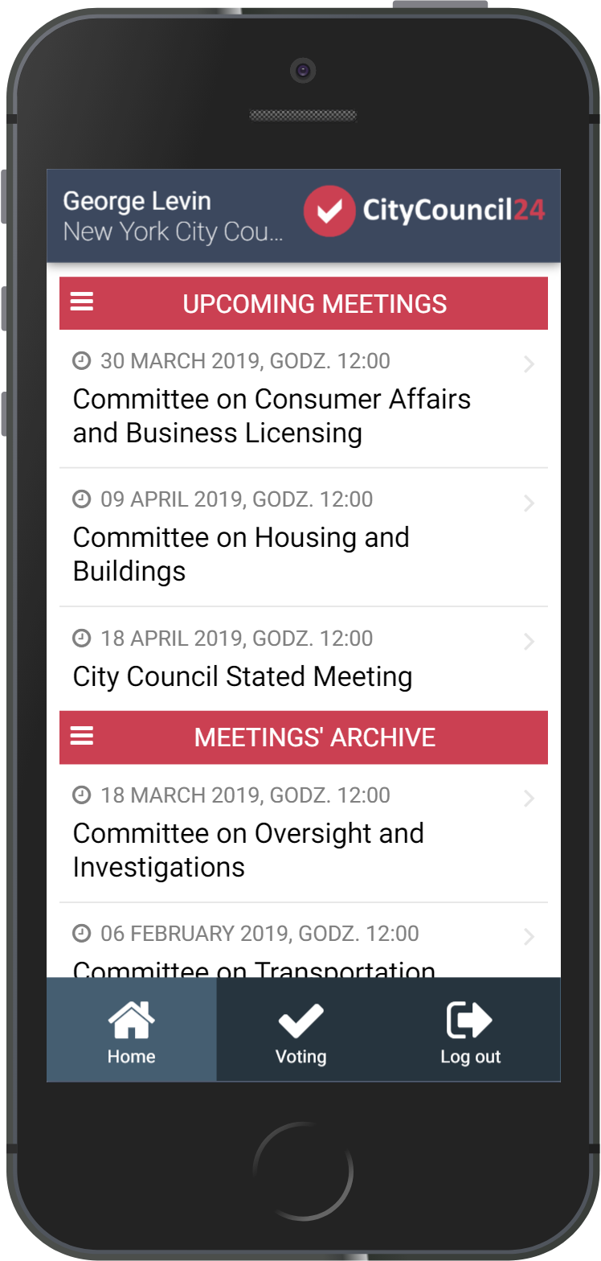

Your voting system for City Council
and other public institutions

Slide 2
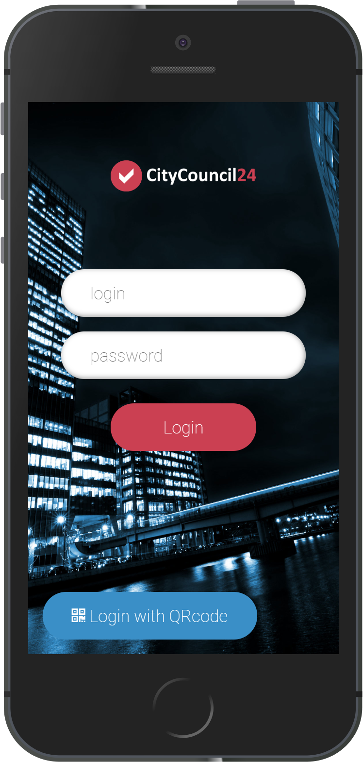
What is CityCouncil24?
Simple and secure system for voting using new or existing mobile devices
CityCouncil24 voting engine is the most popular voting engine in Polish selfgovernments (over 700 City Councils, over 250.000 votings since 2011)
Doesn’t require IT infrastructure, works as SaaS using internet
The fastest and cheapest voting system working on smartphones, tablets and laptops
Perfect supplement for existing conference systems, fully compatible with Monacor and JTS systems
Fully translatable to other languages

Slide 3
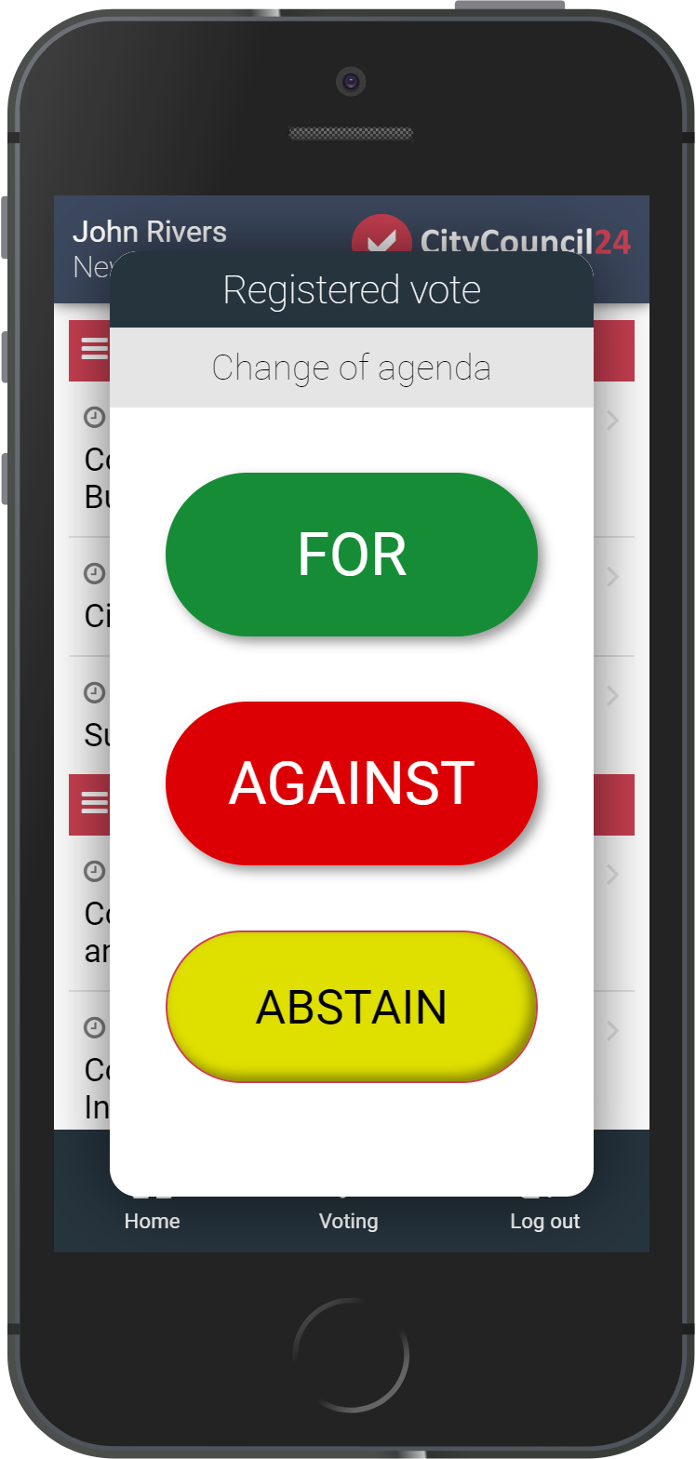
How does it work?
Manage meetings and voting using your favourite web browser
Provide smartphones or tablets to the City Council members or use devices that they already own
Prepare accounts for City Council members using web interface (you can change them at any time, even during a meeting)
City Council members log in using provided login and password or using their smartphone camera by scanning the QR Code
City Council members can see the meeting agenda on their device and vote using large buttons displayed on the screen

Slide 4
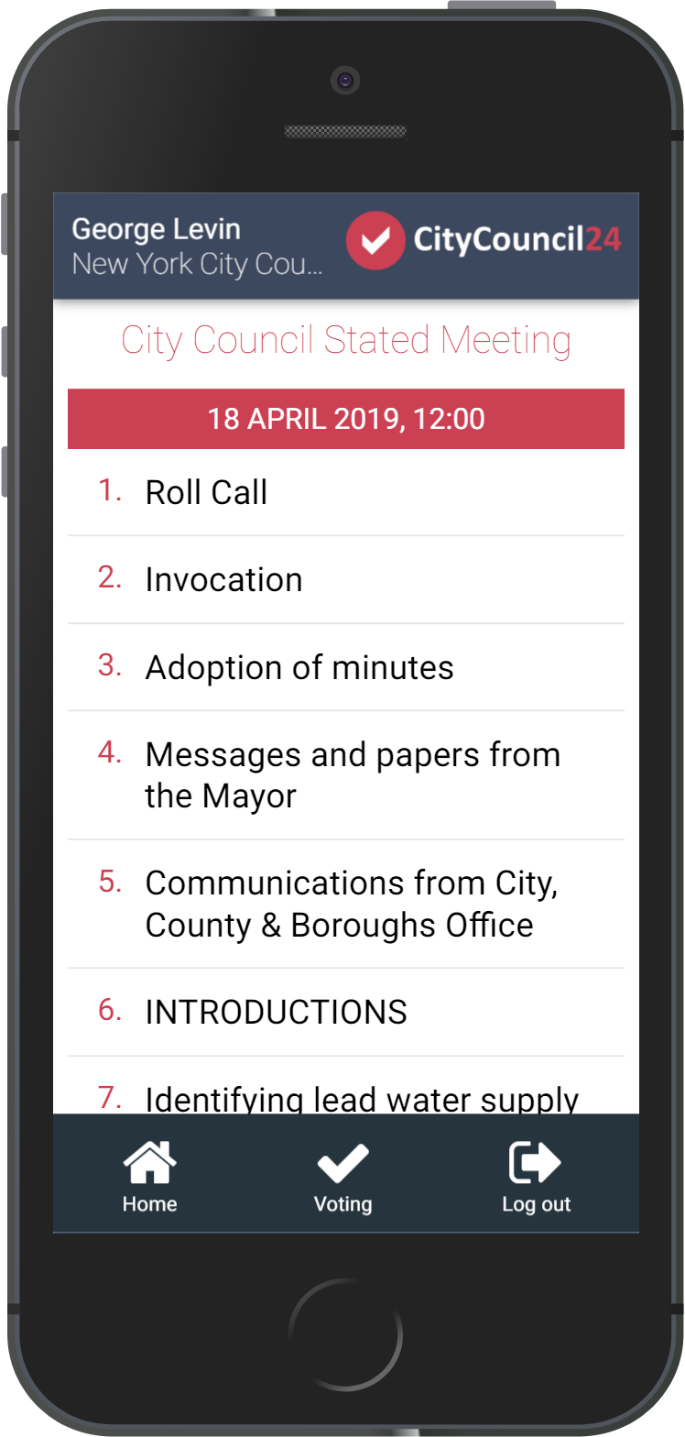
Business model
Sold in SaaS model
Each Customer pays subscription fee every month, quarter or year
The amount to pay depends on the number of voting users
Reseller discounts for up to 50%
Reseller can also earn by selling the voting devices (like 7” tablets) and training

Slide 5
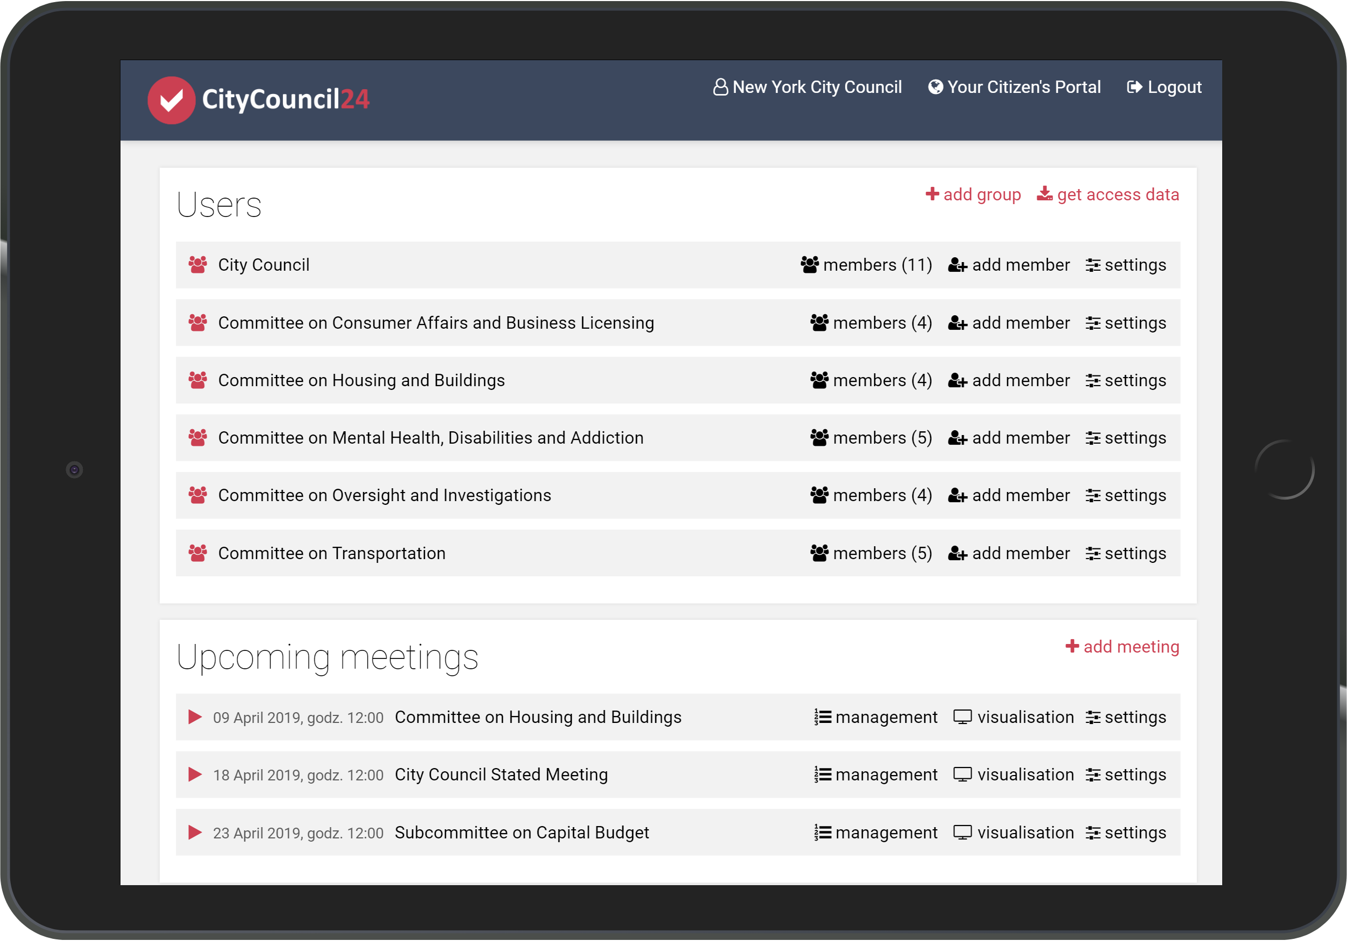
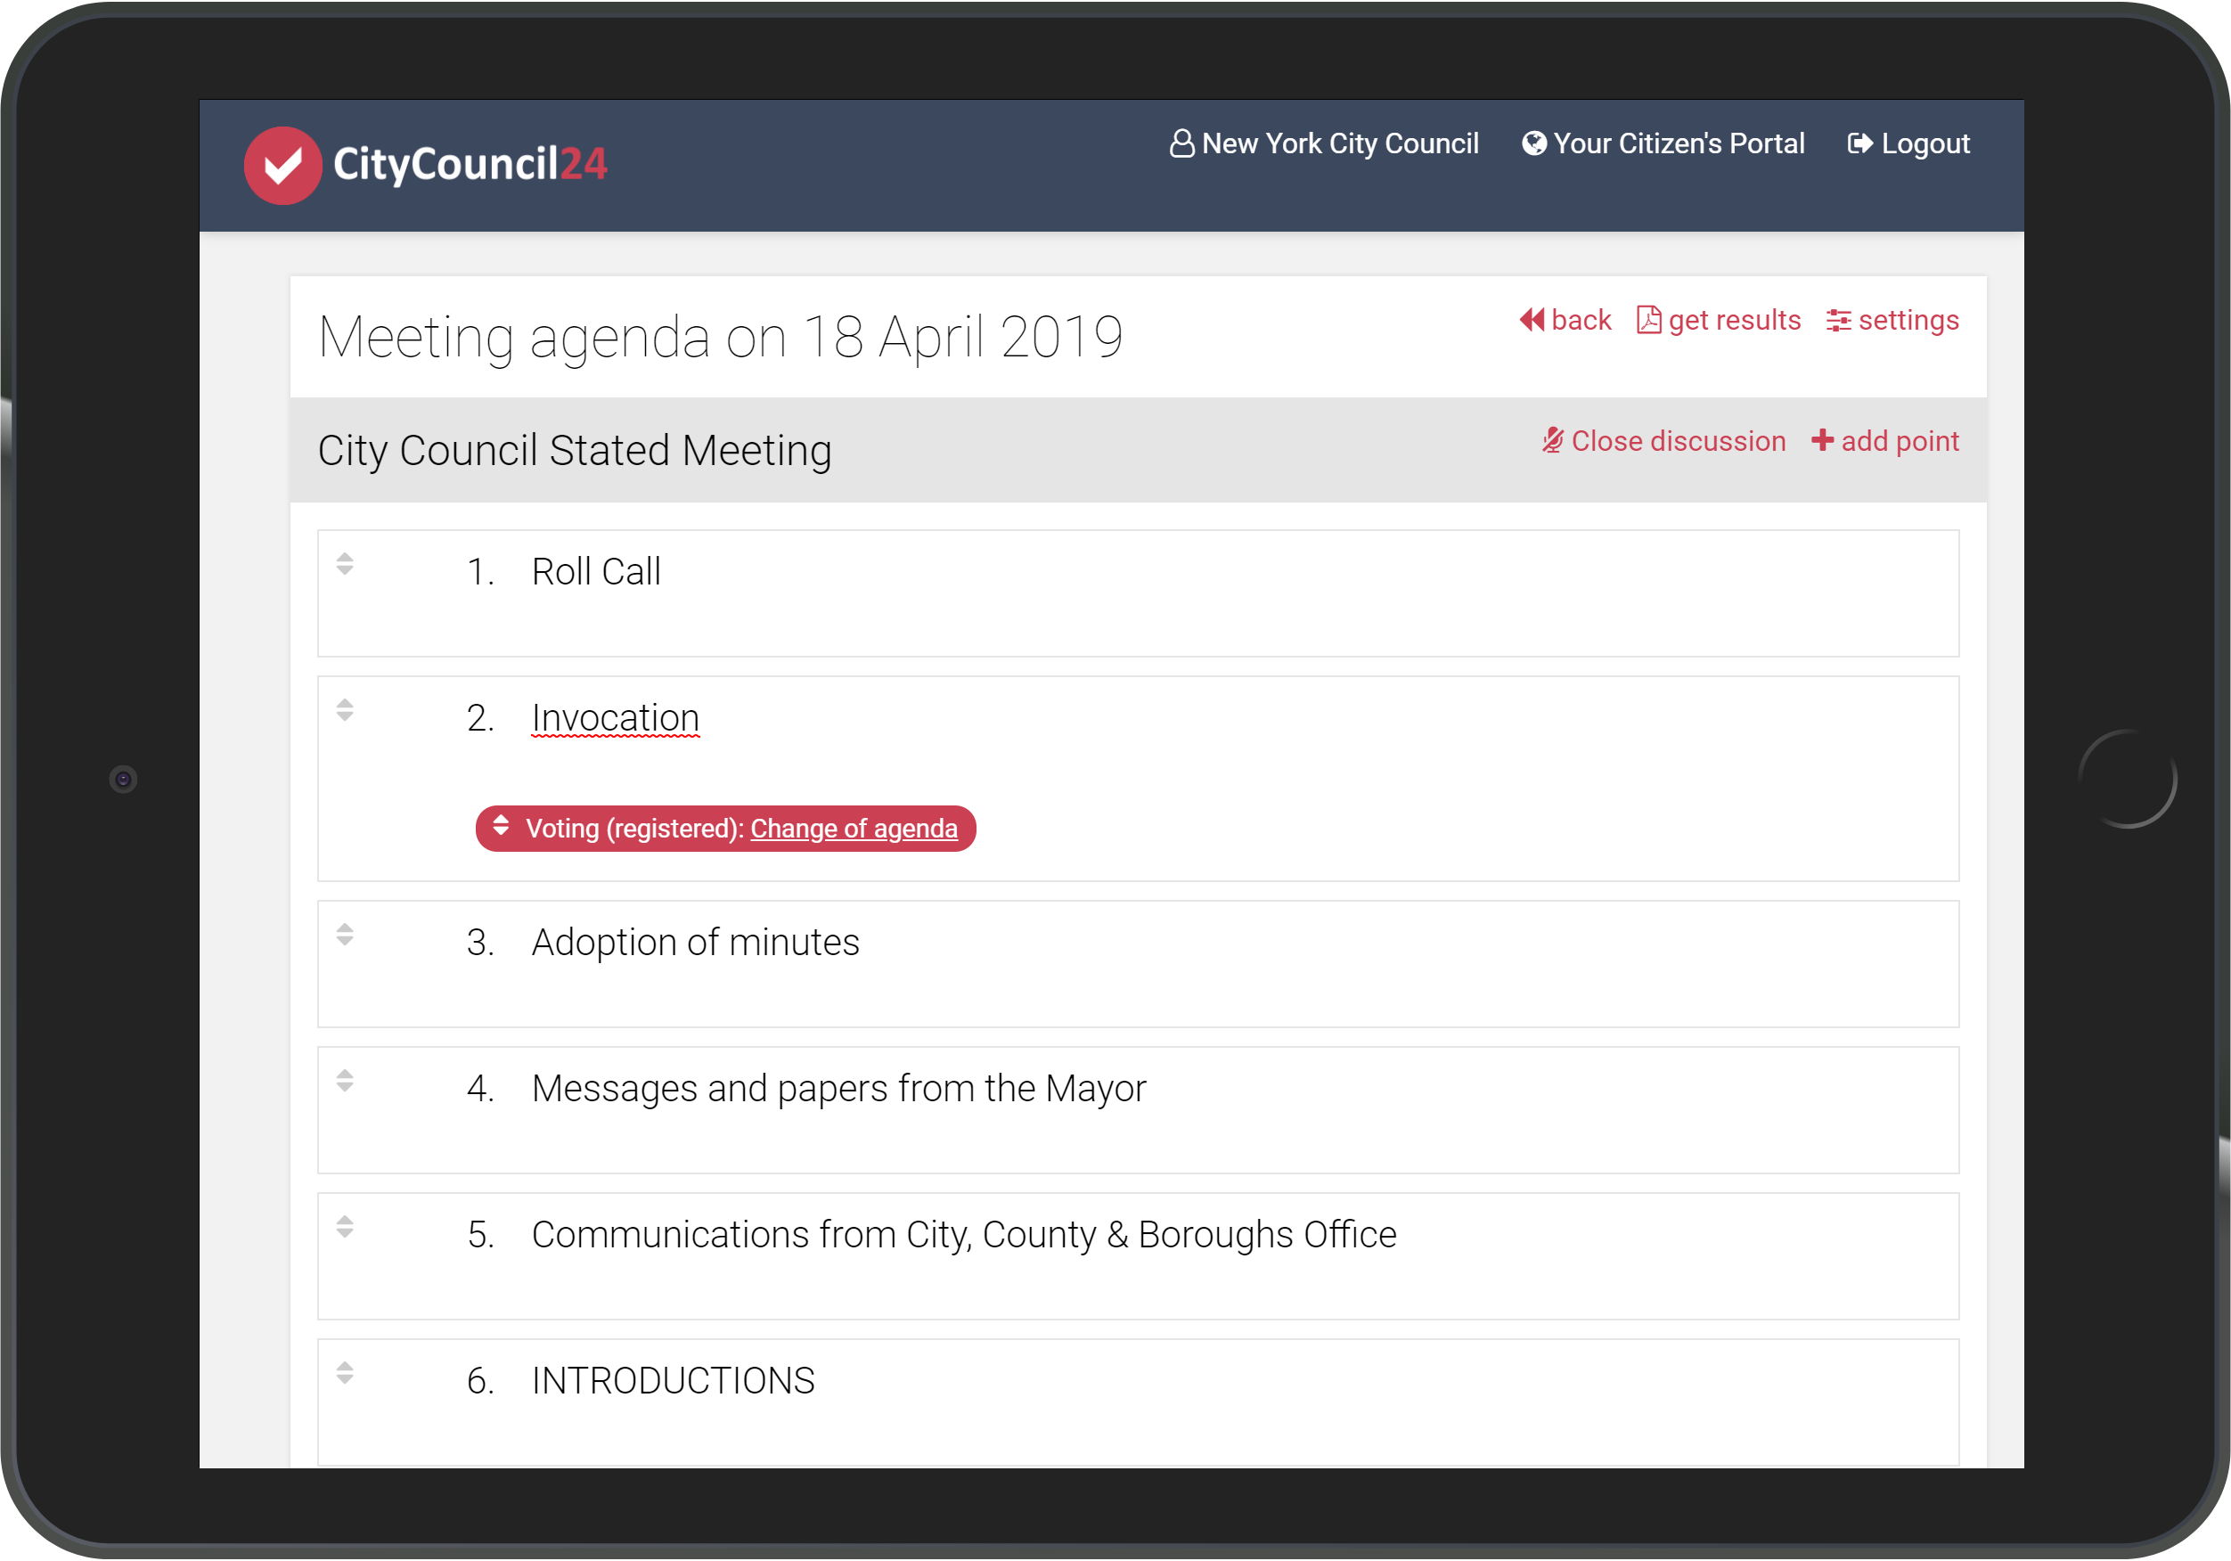
Web dashboard
Editable groups and meetings list
Agenda and votings editor

Slide 6
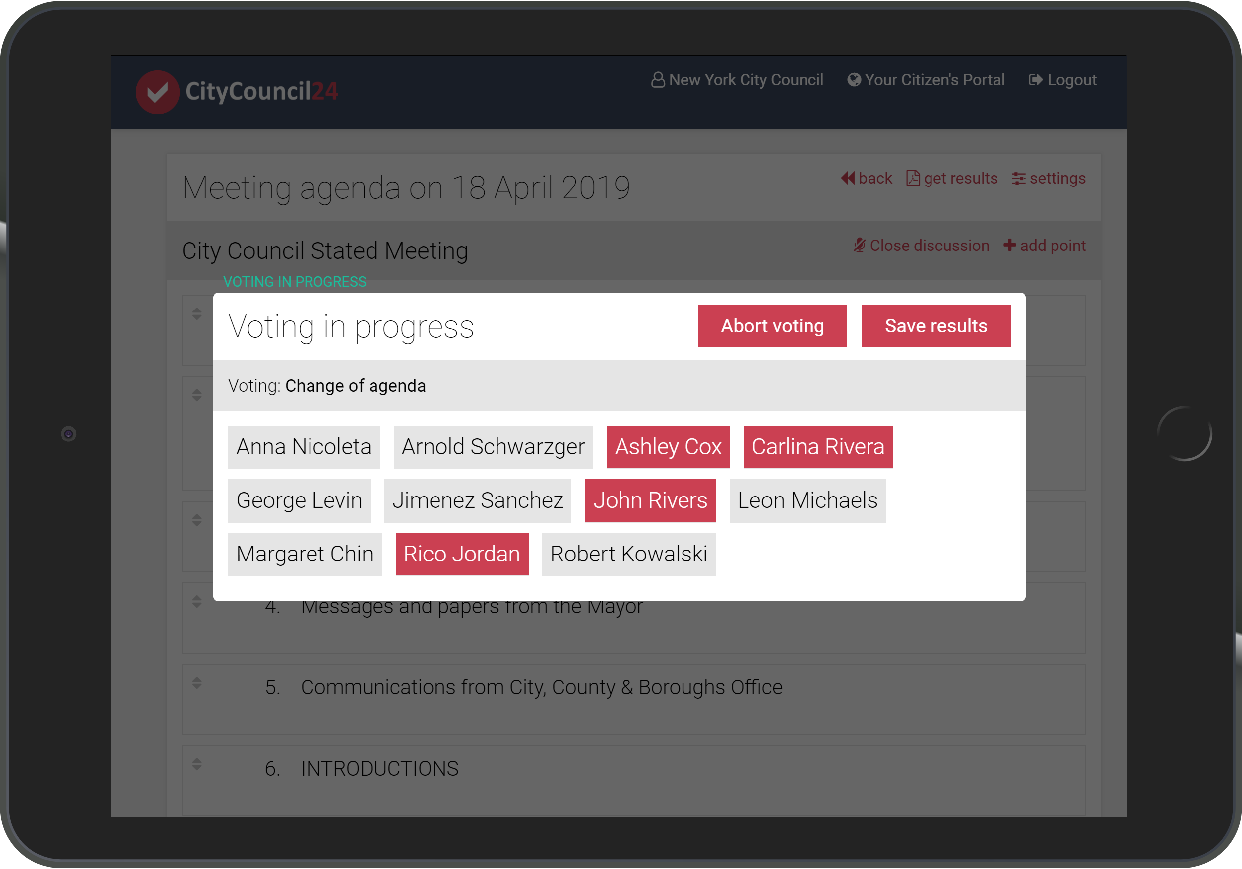
Web dashboard
Voting in progress

Slide 7
AV Integrations
Easy integration with AV systems
CityCouncil24 can automatically publish voting results in real time as an overlay to the video stream from the meeting

Slide 8

About MW Concept
MW Concept is the biggest voting systems developer and distributor in Poland
The biggest Conference systems distributor in Poland
Developing multiple voting systems since 2011
Our products: www.esesja.pl, www.glosuj24.pl, www.pilotydoglosowania.pl, www.rada24.pl

